Slide 1

Software Paradigms
Eamonn de Leastar (edeleastar@wit.ie)
Dr. Siobhan Drohan (sdrohan@wit.ie)
Produced
by:
Department of Computing and Mathematics
http://www.wit.ie/

Slide 2
Literate Programmer…
“Good design and programming is not learned by generalities, but by seeing how significant programs can be made clean, easy to read, easy to maintain and modify, human-engineered, efficient, and reliable, by the application of good design and programming practices. Careful study and imitation of good designs and programs significantly improves development skills."
Kernighan & Plauger (1978)

Slide 3
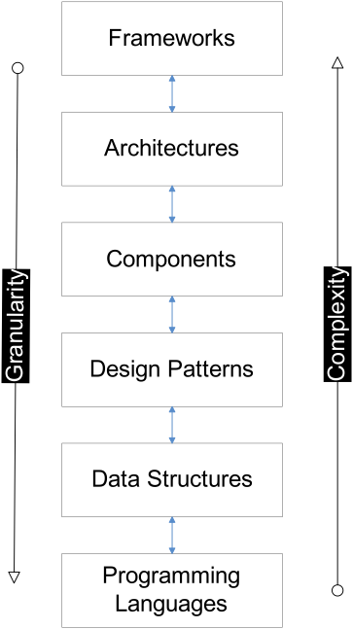
Agenda
Software & Programming Paradigms
Software Engineering Knowledge Stack

Slide 4
Software Paradigms…
Paradigm* is commonly used to refer to a category of entities that share a common characteristic.
Taken to mean a conceptual way of describing something
The rate of change in the software discipline has seen proliferation of overlapping paradigms.
*from Greek paradeigma, ‘show side by side’,

Slide 5
Software Paradigms (examples..)
Imperative programming – defines computation as statements that change a program state.
Procedural programming, structured programming – specifies the steps a program must take to reach a desired state.
Declarative programming – defines program logic, but not detailed control flow.
Functional programming – treats programs as evaluating mathematical functions and avoids state and mutable data
Object-oriented programming (OOP) – organizes programs as objects: data structures consisting of datafields and methods together with their interactions.
Event-driven programming – program control flow is determined by events, such as sensor inputs or user actions (mouse clicks, key presses) or messages from other programs or threads.
Automata-based programming – a program, or part, is treated as a model of a finite state machine or any other formal automaton.

Slide 6
Software Paradigms
"Paradigm" (example in Greek) is commonly used to refer to a category of entities that share a common characteristic.
Taken to mean a conceptual way of describing something
The rate of change in the software discipline has seen numerous paradigms.

Slide 7
A fundamental change in the basic concepts and experimental practices of a scientific discipline.
Can be a period of confusion & uncertainty

Slide 8
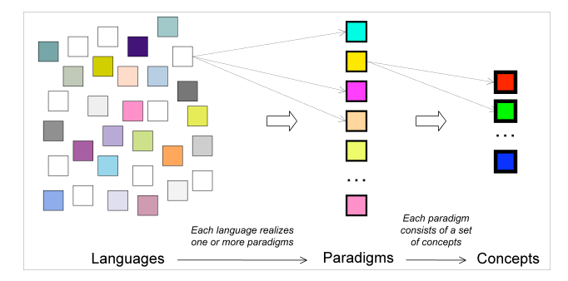
Software Paradigms
Roy, Peter van (2009)

Slide 9
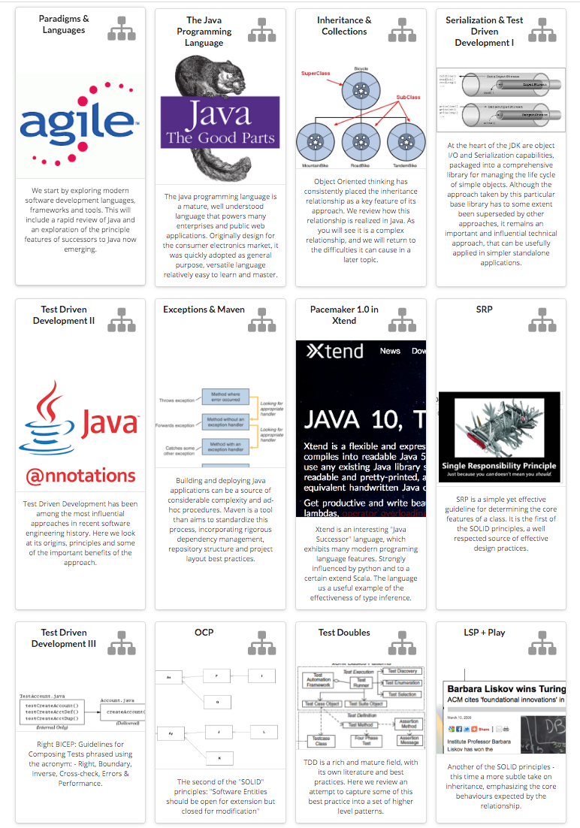
Paradigms for This Module
Object Oriented Programming
OO Principles (particularly SOLID principles)
Java Programming Language
Kotlin Programming Language
Agile Methods
Test Driven Development (TDD)
Automated Build / Configuration Management
Network Programming
Web Services/HTTP/REST

Slide 10
Knowledge Context

Slide 11
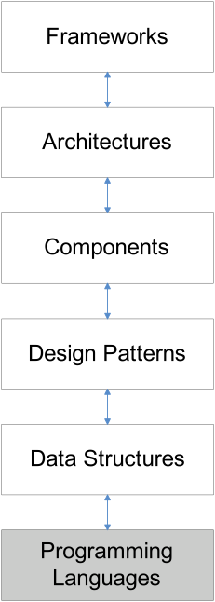
Programming Languages
A programming language is a system of signs used to communicate a task/algorithm to a computer, causing the task to be performed.
The task to be performed is called a computation, which follows absolutely precise and unambiguous rules.
Three components:
The syntax of the language is a way of specifying what is legal in the phrase structure of the language; (analogous to knowing how to spell and form sentences English)
The second component is semantics, or meaning, of a program in that language.
Certain idioms that a programmer needs to know to use the language effectively - are usually acquired through practice and experience.

Slide 12
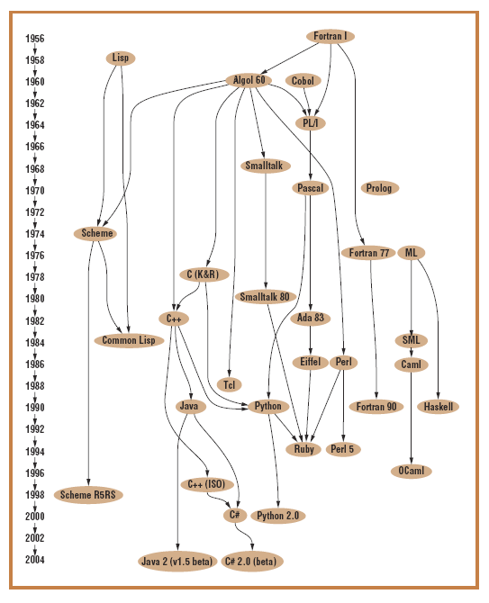
Family Tree
Imperative languages: (Fortran, C, and Ada) enable programmers to express algorithms for solving problems.
Declarative languages, (Lisp, Prolog, Haskell) allow the programmer to specify what has to be computed, but not how the computation is done.
Object Oriented: can be viewed as a hybrid – of declarative (class structures) & imperative (methods) features.

Slide 13
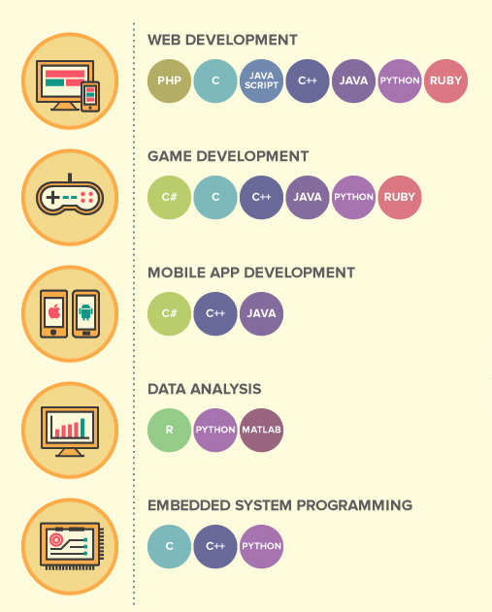

Slide 14
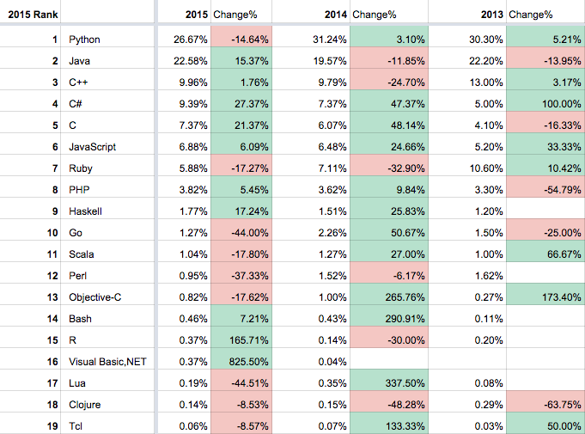
http://blog.codeeval.com/codeevalblog/2016/2/2/most-popular-coding-languages-of-2016

Slide 15
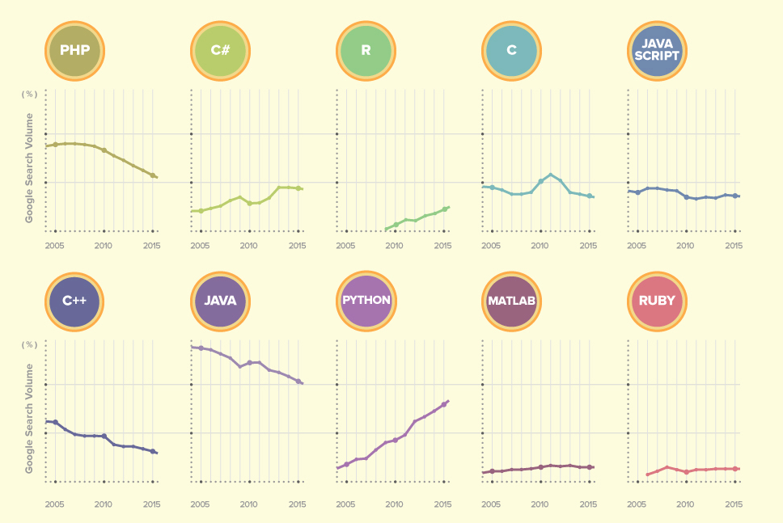
https://blog.udacity.com/2015/05/pick-your-first-programming-language.html

Slide 16
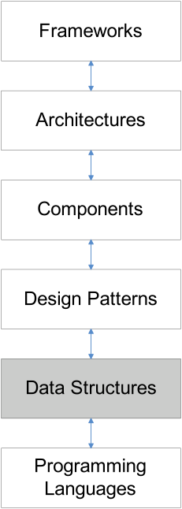
Data Structures & Problems
Typical Data Structures:
Lists, Maps, Stacks, Queues, Trees, etc.
Static and Dynamic implementations
Typical Problem Categories:
Search
Sorting
Traversal
Inserting / Deleting
Merging
Clustering
Classification

Slide 17
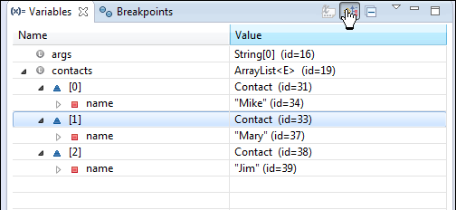
Exploring a Data Structure
public class Contact
{
private String name;
public Contact(String name)
{
this.name = name;
}
public String toString()
{
return name;
}
}
public class Main
{
public static void main(String[] args)
{
List<Contact> contacts
= new ArrayList<Contact>();
contacts.add(new Contact("Mike"));
contacts.add(new Contact("Mary"));
contacts.add(new Contact("Jim"));
System.out.println(contacts);
}
}

Slide 18
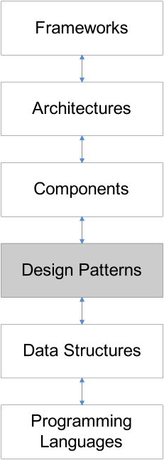
Design Patterns
A design pattern is a proven solution for a general design problem.
It consists of communicating ‘objects’ that are customised to solve the problem in a particular context.
Patterns have their origin in object-oriented programming; they are pre-packaged Object-oriented design knowledge that allows you to create more flexible and maintainable code.
There isn't any fundamental relationship between patterns and objects; it just happens they began there.
Patterns may have arisen because objects seem so elemental, but the problems we were trying to solve with them were so complex.
Notes:
Information directly from Lynda Course: Foundations of Programming – Design Patterns
What are Design patterns?
“design patterns are general solutions for common problems that crop up in all kinds of software systems. For instance, you might be working through your class design, and discover that if one object changes, several other objects need to know about that change. Is there a way to structure objects so they aren't too tightly dependent on one another? This is the kind of problem that you'll encounter in software systems across all domains.”
“ Think of design patterns as guidelines for how to structure your objects and their behavior to get a particular result.”
“The primary goal of any designing pattern is to help you structure your code so it is flexible and resilient.”
“All patterns let some part of the code vary independently of the other parts”.

Slide 19
Why the need for Design Patterns?
Change is a constant in software design e.g. bugs, new features, changes to design, new regulations, etc. All software changes, so your designs should be ready for it.
They allow you to typically anticipate common ways that systems grow and change over time.
The primary goal of any design pattern is to help you structure your code so it is flexible and resilient.
All patterns let some part of the code vary independently of the other parts.
Notes:
Information directly from Lynda Course: Foundations of Programming – Design Patterns

Slide 20
Pattern Levels
Architectural Patterns:
Expresses a fundamental structural organization or schema for software systems. It provides a set of predefined subsystems, specifies their responsibilities, and includes rules and guidelines for organizing the relationships between them.
Design Patterns:
Provides a scheme for refining the subsystems or components of a software system, or the relationships between them. It describes commonly recurring structure of communicating components that solves a general design problem within a particular context.
Idioms:
A low-level pattern specific to a programming language. An idiom describes how to implement particular aspects of components or the relationships between them using the features of the given language.

Slide 21
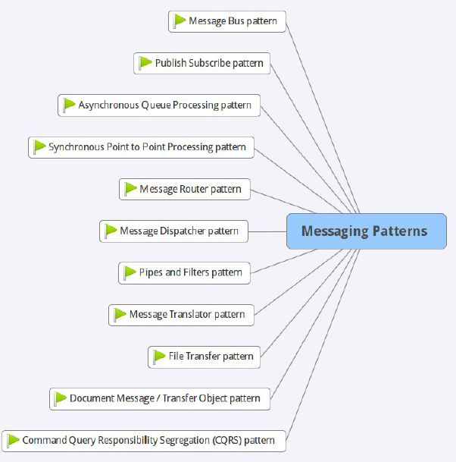
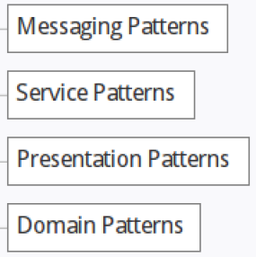
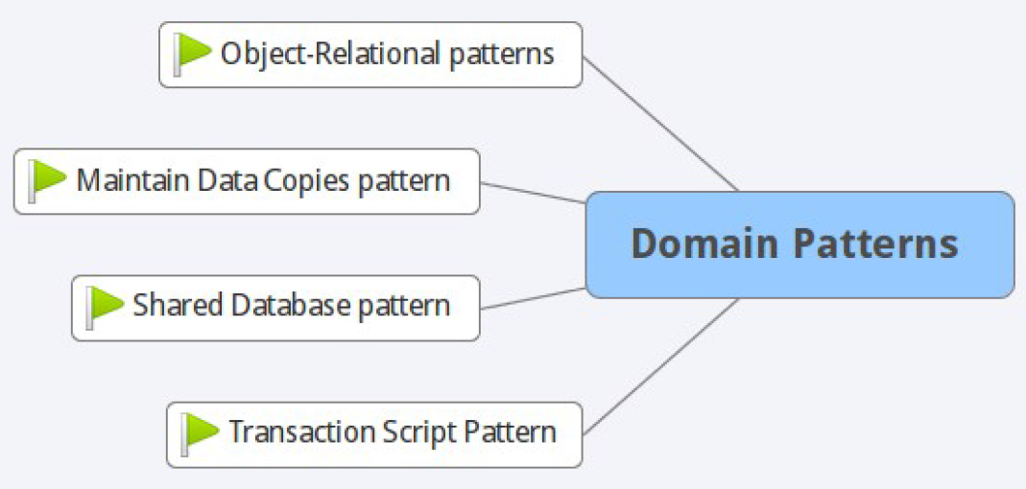
Architectural Patterns Examples
Note: this area is covered in detail in the Design Patterns Module.

Slide 22
Singleton Pattern
public class FileLogger{
private static FileLogger logger;
private FileLogger(){
}
public static FileLogger getLogger(){
if (logger == null){
logger = new FileLogger();
}
return logger;
}
public boolean log(String msg){
try{
PrintWriter writer = new PrintWriter(new FileWriter("log.txt", true));
writer.println(msg);
writer.close();
}
catch (FileNotFoundException ex){
return (false);
}
catch (IOException ex){
return (false);
}
return (true);
}
}

Slide 23
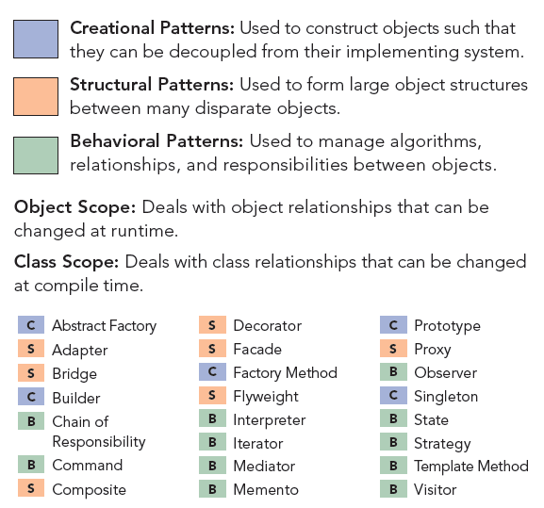
Design Patterns Examples
Note: this area is covered in detail in the Design Patterns Module.
https://dzone.com/refcardz

Slide 24
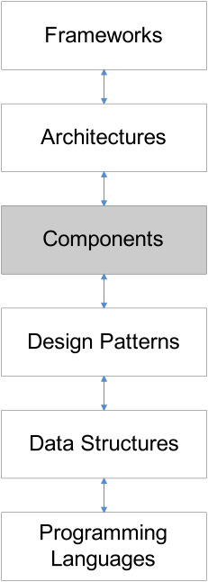
Components
Software components are binary units of:
independent production,
acquisition,
deployment
that interact to form a functioning program. (Szyperski, 1998)
Emphasis on reusable units.
A component must be compatible and interoperate with a whole range of other components.
Two main issues arise with respect to interoperability information:
How to express interoperability information
How to publish this information

Slide 25
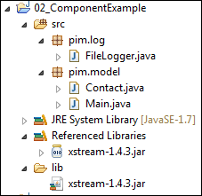
Exploring a Component (xstream-1-4-3.jar)
public class Main{
public static void main(String[] args) throws IOException{
FileLogger logger = FileLogger.getLogger();
logger.log("Creating contact list");
List<Contact> contacts = new ArrayList<Contact>();
logger.log("Adding contacts");
contacts.add(new Contact("Mike"));
contacts.add(new Contact("Mary"));
contacts.add(new Contact("Jim"));
System.out.println(contacts);
logger.log("Serializing contacts to XML");
XStream xstream = new XStream(new DomDriver());
ObjectOutputStream out =
xstream.createObjectOutputStream
(new FileWriter("contacts.xml"));
out.writeObject(contacts);
out.close();
logger.log("Finished - shutting down");
}
}
<object-stream>
<list>
<pim.model.Contact>
<name>Mike</name>
</pim.model.Contact>
<pim.model.Contact>
<name>Mary</name>
</pim.model.Contact>
<pim.model.Contact>
<name>Jim</name>
</pim.model.Contact>
</list>
</object-stream>

Slide 26
More Component Definitions
"A component is a nontrivial, nearly independent, and replaceable part of a system that fulfills a clear function in the context of a well-defined architecture. A component conforms to and provides the physical realization of a set of interfaces." (Philippe Krutchen, Rational Software)
"A runtime software component is a dynamically bindable package of one or more programs managed as a unit and accessed through documented interfaces that can be discovered at runtime." (Gartner Group)
"A component is a physical and replaceable part of a system that conforms to and provides the realization of a set of interfaces...typically represents the physical packaging of otherwise logical elements, such as classes, interfaces, and collaborations." (Grady Booch, Jim Rumbaugh, Ivar Jacobson, The UML User Guide, p. 343)

Slide 27
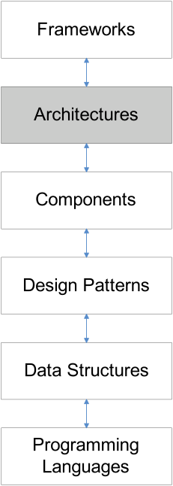
Architecture
The software architecture of a program or computing system is:
the structure or structures of the system, which comprise software components,
the externally visible properties of those components, and
the a set of rules that govern relationships among them.
An architectural style is a family of software architectures, defining types of components and types of connections, and rules describing how to combine them.
A software architecture is an instantiation of an architectural style for a certain system. The components and connections may be decomposed into architectures themselves.

Slide 28
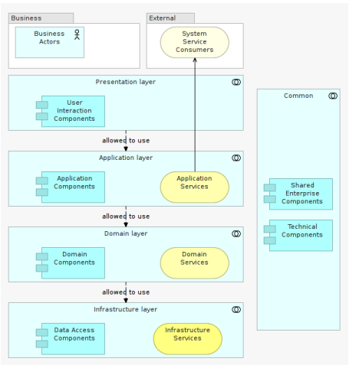
Architecture Example: Layered
Source: Pierre Peclier,
Design Patterns Module
Notes:
http://wit-design-patterns-2016.github.io/part-1/topic09-principles-and-styles/talk-2/b-architecture-styles.pdf

Slide 29
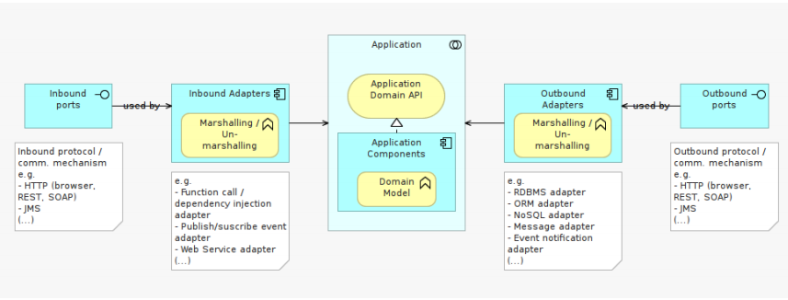
Architecture Example: Ports and Adaptors
Source: Pierre Peclier,
Design Patterns Module

Slide 30
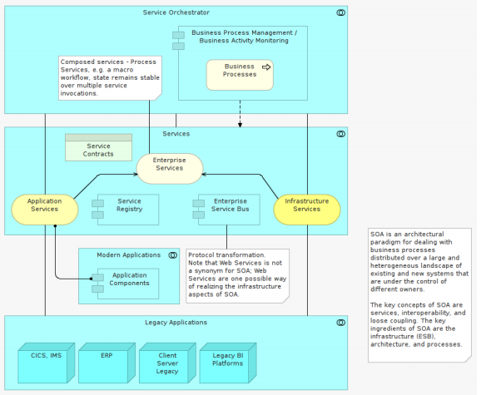
Architecture Example: Service Oriented
Source: Pierre Peclier,
Design Patterns Module

Slide 31
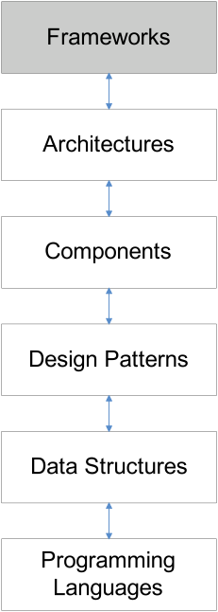
Frameworks
A framework is a set of related components which you:
Specialize
Integrate and/or
Instantiate
to implement an application or subsystem.
A framework is usually a semi complete application containing dynamic and static components that can be customized to produce applications.

Slide 32
Frameworks
Frameworks are targeted for a particular application domain & consists of a set of classes (abstract & concrete), whose instances:
collaborate
are intended to be extended, i.e. reused (abstract design)
do not have to address a complete application domain (allowing for composition of frameworks)
Emphasize stable parts of the domain and their relationships and interactions.

Slide 33
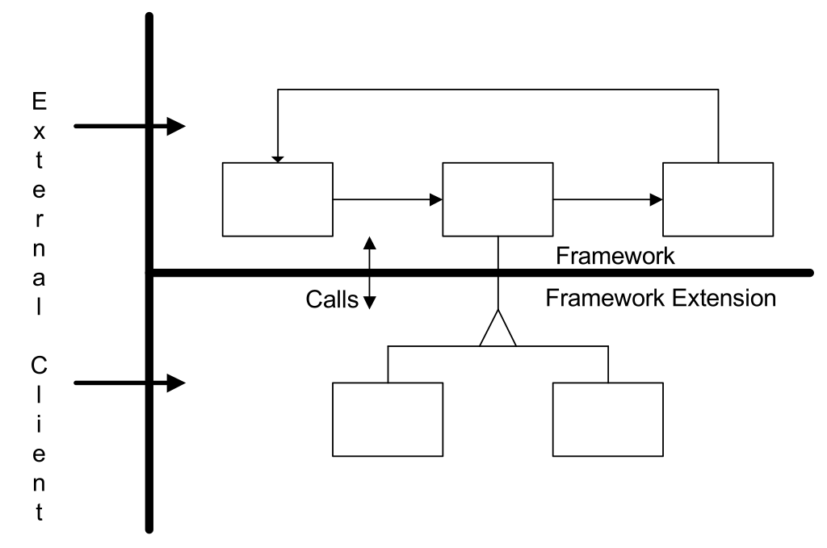
Framework Structure

Slide 34
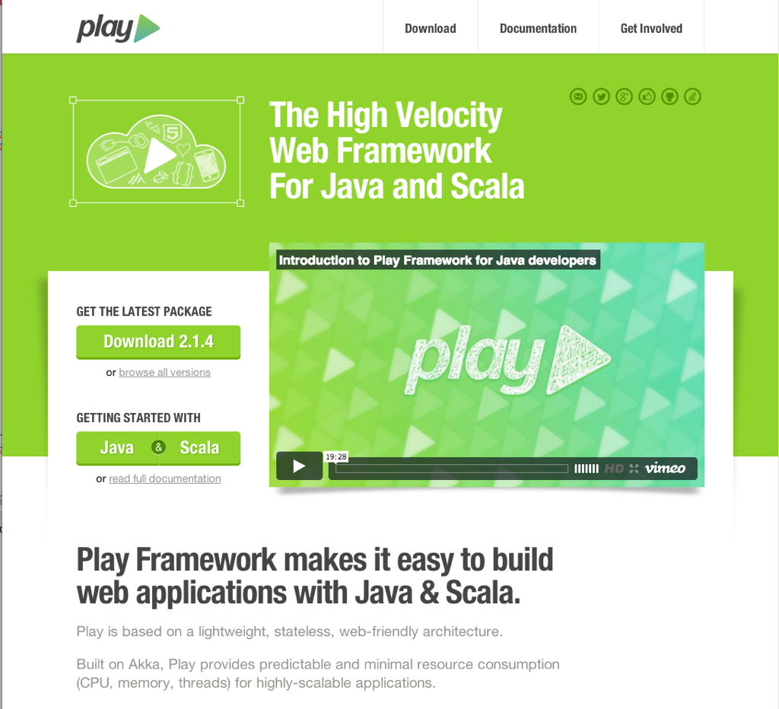
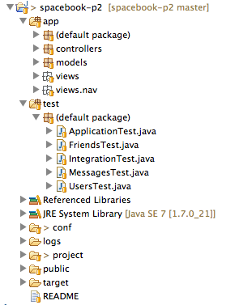
Framework Example

Slide 35
Agile Software Development Module
Assumptions:
General Programming Ability (not necessarily java)
Focus for this course:
SOLID Principles within OO Programming
Test Driven Software Development in Java
Effective Build Processes
Network Programming
Beyond Java (Kotlin)

